Slide 1
Astro 331 Lesson 27
Assembly, Integration and Test (AI&T)
SMAD Ch 12, Supp Crs Mtl

Slide 2
Lesson Objectives
Understand common hardware nomenclature
Understand why items are tested at the unit and subassembly level before integration into the vehicle
Describe the differences in intent and application of qualification, protoqualification, and acceptance testing
Understand and describe a flow chart of vehicle-level tests and explain why the tests are conducted in a particular order
Explain the purpose of electromagnetic compatibility, shock, and thermal vacuum testing
Understand the purpose of and differences between spacecraft acoustic tests, sinusoidal sweep vibration tests and random vibration tests
Explain the phrase “test like you fly” and give examples of some test considerations

Slide 3
*Note
Most of the material from this lesson comes directly from MIL-STD-1540E, Test Requirements for Launch, Upper-Stage, and Space Vehicles
It would behoove you to read through it…
TYLF info comes from Aerospace Report

Slide 4
Hardware Nomenclature
Piece part: individual part such as resistor, integrated circuit, bearing, circuit board or housing
Component: complete functional unit such as a control electronics assembly, an antenna, a battery, or a power control unit
Assembly: functional group of parts such as a hinge assembly, an antenna feed, or a deployment boom
Subsystem: all of the components and assemblies that comprise a spacecraft subsystem
Spacecraft: complete vehicle made up of all subsystems and the payload

Slide 5
Test Levels
Unit Test: testing a component before it is integrated into subsystem, to ensure it works as expected and meets all unit-level requirements
Note: we expect that suppliers of piece parts test individual piece parts before sending to the contractor to build, so “unit test” refers to tests at the component level
Subsystem Test: testing a subsystem before it is integrated into the vehicle, to ensure all components work together as expected to meet subsystem-level requirements
Vehicle Test: testing all subsystems together, to ensure they all work together as expected across range of requirements

Slide 6
Test Categories
Functional: demonstrates all functional capabilities expected from an article (unit, subsystem, vehicle); ie, gives expected telemetry, receives expected commands, etc.
Acceptance: demonstrates acceptability of each deliverable item to meet performance specification and demonstrate error-free workmanship in manufacturing
Lowest test level, required by all flight items
Meets all requirements over expected ranges (temperatures, stress, etc)
Qualification: demonstrates that the design, manufacturing process and acceptance program produce hardware/software that meet specification requirements with adequate margin
Highest test level, ensures that units will remain flight-worthy after surviving multiple acceptance tests
Meets all requirements beyond expected ranges, intended to stress items
Sometimes performed on test units, rather than flight units
Protoqualification: hybrid of qualification and acceptance testing; applies reduced qualification-level testing to hardware
Middle test level, would replace qualification
Uses flight units for testing
Compromise for qualification testing, when it is not practical/affordable to have a full engineering model to qualification test
First unit is put through protoqualification test levels, subsequent vehicles are just acceptance tested (sometimes called “qualification by similarity”)

Slide 7
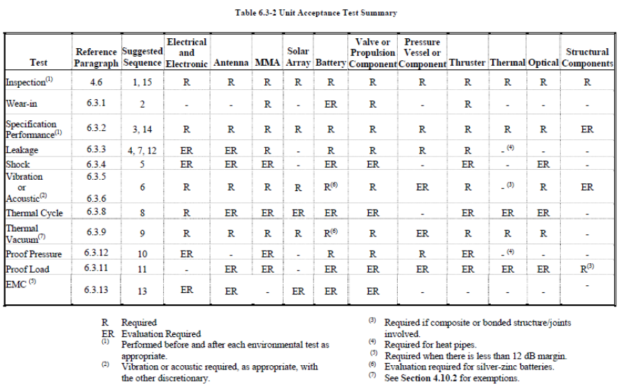
Unit Level Acceptance
Test is to expected on-orbit levels
Unit is flight-worthy

Slide 8
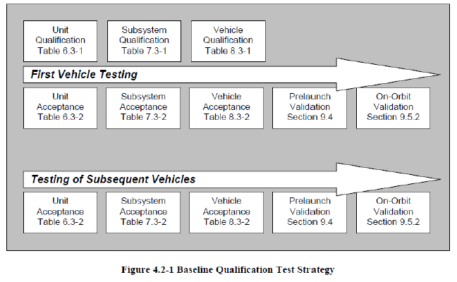
Qualification
Qualified item is non-flight
Subsequent flight items are then acceptance tested

Slide 9
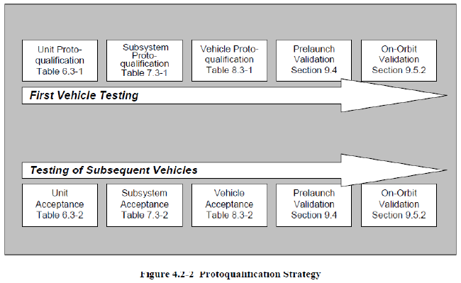
Protoqualification
Protoqualified item is flight
Subsequent flight items are then acceptance tested

Slide 10
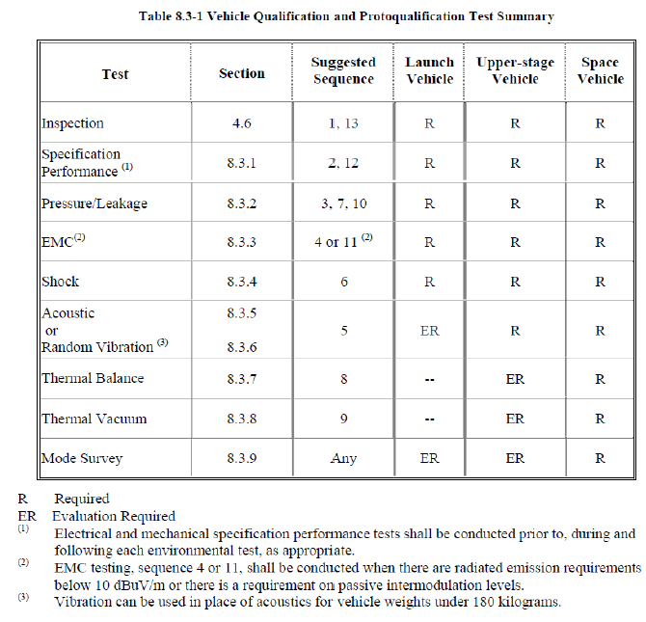
Vehicle Level Test Summary

Slide 11
Example Integration & Test Flow
Spacecraft Assembly & Integration Complete
Inspection
Full Functional Test
1
2
3
Vibe
Acoustic
EMC
Pressure/Leakage Test
7
6
5
4
Shock/Deployment
Pressure/Leakage Test
Thermal Balance/TVAC
8
9
10
Inspection
Full Functional Test
Pressure/Leakage Test
13
12
11

Slide 12
Test Types

Slide 13
Specification Performance (“Full Functional”) Test
Verifies that the mechanical and electrical performance of the vehicle meets requirements, including compatibility with GSE (ground support equipment) and validates all test software and techniques
Demonstrates operation of all redundant units

Slide 14
Pressure and Leakage Tests
Demonstrate the capability of pressurized subsystems to meet specified flow, pressure and leakage rate requirements

Slide 15
Electromagnetic Interference & Compatibility (EMI & EMC) Test
Demonstrates electromagnetic compatibility of vehicle to operating environment (launch is bigger concern – both LV and ground communicating w/ LV, on-orbit operations have less interference)
Two major types:
1. Conducted & Radiated Emissions:
Conducted: consists of electromagnetic interference in circuits that could create issues in delivered power quality due to interference caused by harmonics due to linear and non-linear loads present in the electrical power subsystem and harnessing
Radiated: comes from antenna when it produces its waveform
2. Conducted & Radiated Susceptibility: ability of a system to operate acceptably when subjected to electromagnetic interference (conducted) and radio frequency voltage or current (radiated)
Tested by having expected radio frequencies (from LV or ground) radiated at vehicle while performing nominal operations

Slide 16
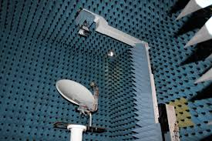
Anechoic Chamber
Image Courtesy of
Technische Universitat Wien

Slide 17
Shock/Deployment Test
Demonstrates the capability of the vehicle to withstand induced shock environments (ie, launch vehicle separation, solar array deployment, etc)

Slide 18
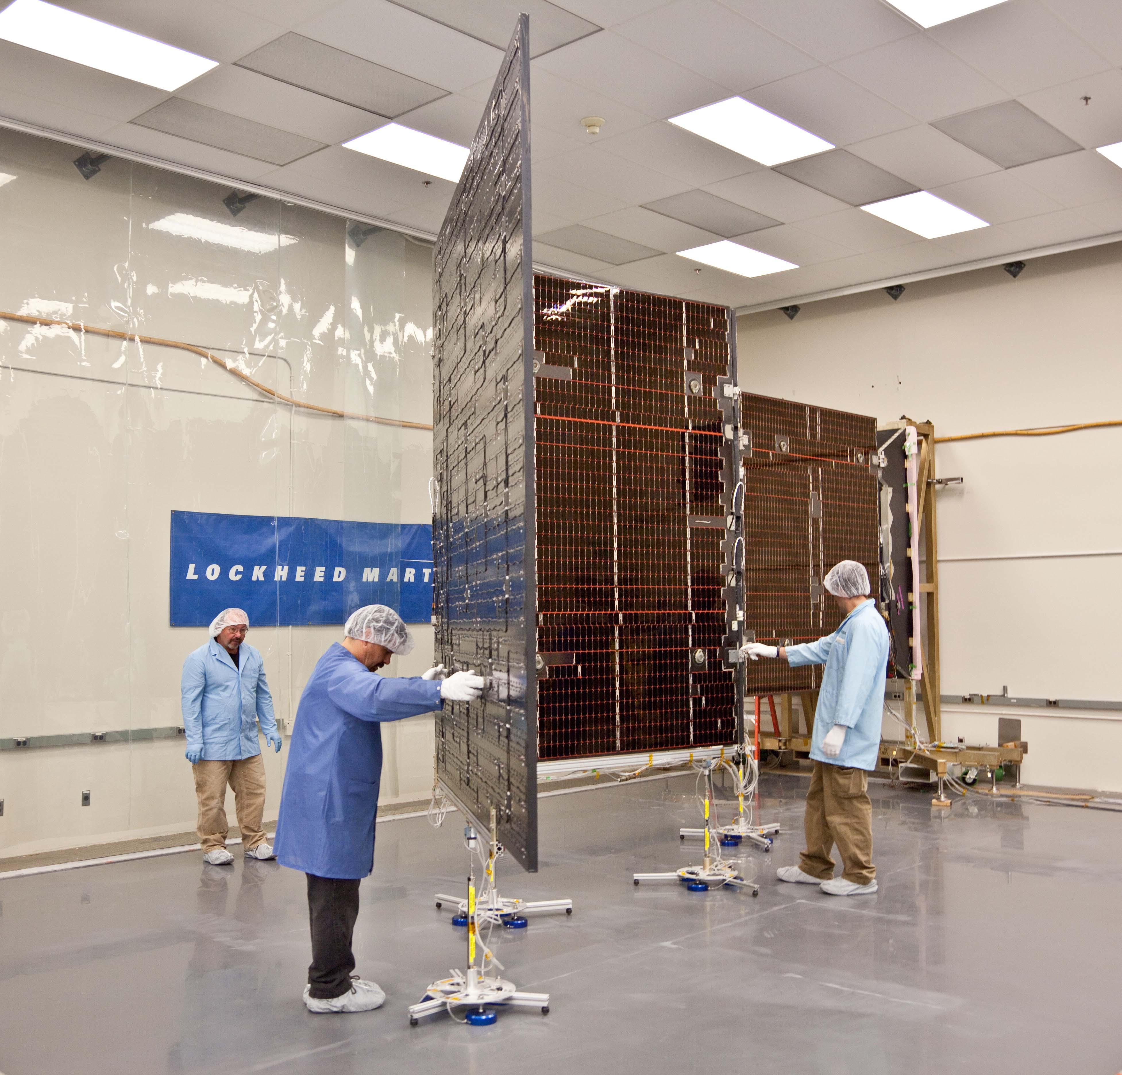
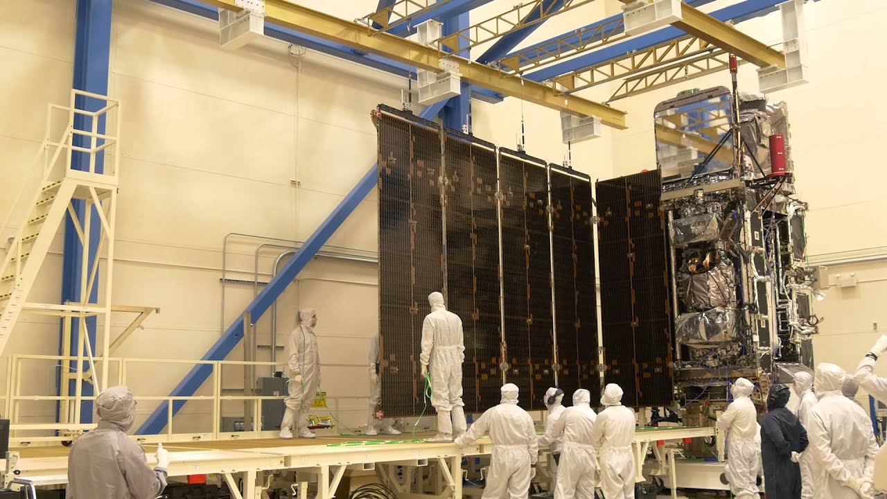
Solar Array Deployment: Juno & GOES-R
Image Courtesy of
pds-rings.seti.org
Image Courtesy of
pds-rings.seti.org

Slide 19
Acoustic Test
Demonstrates ability of the vehicle to endure high-frequency (>100 Hz) acoustic environment during launch and ascent
Detects manufacturing and workmanship errors stimulated by higher frequencies

Slide 20
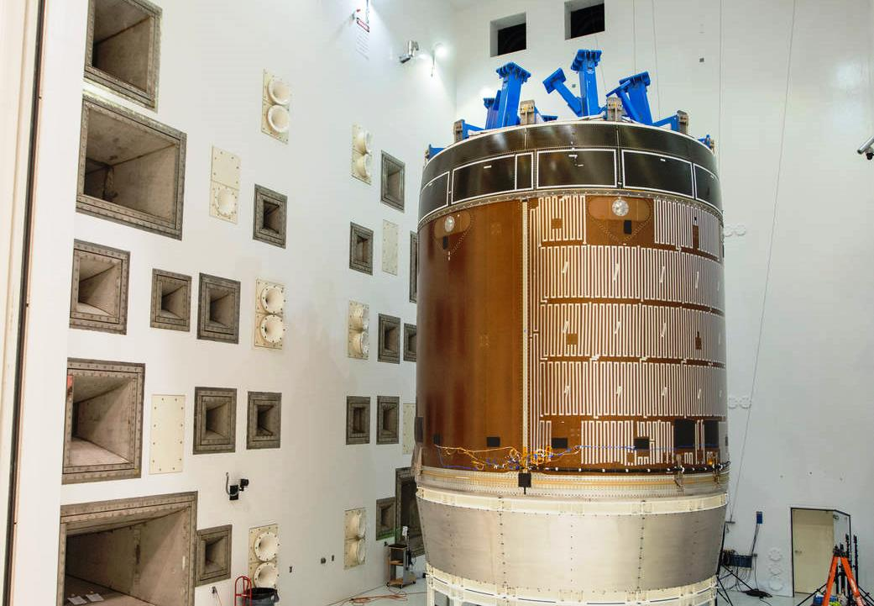
Acoustic Chamber (Orion Service Module)
Image Courtesy of
spaceflightinsider.com

Slide 21
Vibration Test
Demonstrates ability of the vehicle to endure the low-to-mid frequency (0-100 Hz) launch environment and verify expected modes and damping
Detects manufacturing and workmanship errors stimulated by low-to-mid frequencies
Two approaches:
Random: derived to approximate sine vibration of launch vehicle, used with a force-limiting approach to limit loads
Sinusoidal Sweep: sweeps from low to mid-level frequencies at a levels based on expected interface acceleration levels from modelling
Typically perform low-level sine sweeps before and after a random to verify no changes in response

Slide 22
Thermal Tests
Thermal Balance Test
Provides the data necessary to verify the analytical thermal model and demonstrates the ability of the vehicle TCS to maintain specified temperature limits of all units for various operational scenarios
Can be combined with TVAC
Thermal Vacuum Test (TVAC)
Demonstrates ability of vehicle to meet design requirements and establishes thermal design margin and vehicle performance under TVAC conditions and temperature extremes
Detects material, process and workmanship defects that would respond to thermal vacuum and thermal stress conditions

Slide 23
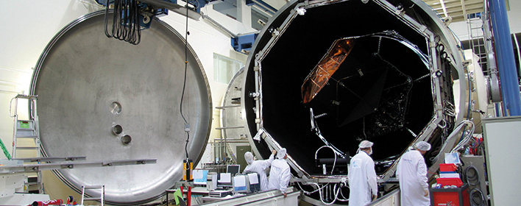
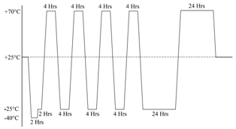
Thermal Vacuum Test
Image Courtesy of Huber+Suhner
Image Courtesy of Scientific & Academic Publishing

Slide 24
Test Like You Fly (TLYF)
Concept of testing a system in the same manner in which it will be used in an operational manner
Very complicated to implement
General considerations:
Flight command & telemetry tested with actual ground software
Fault condition detection
Mode/state changes
Off-nominal condition responses
Post-environmental test repairs tested
Flight-like stimuli for responses, appropriate simulators
Extended test time (DITL, WITL)
Primary and redundant hardware
Exercise at high, low, nominal voltages
Consider how to capture data that verifies that test objectives are met

